Slide 1
Hand Gesture Recognition
By: Abhishek Patil (B_70)
Rushikesh Sonawane (B_113)
Guided by: Mrs. Shalaka Kulkarni
Mrs. Vanita Patil

Slide 2
Introduction
Hand gesture recognition using deep learning is a cutting-edge technology that has gained significant prominence in recent years. This innovative field combines computer vision, machine learning, and neural networks to enable computers and machines to understand and interpret human hand gestures.
The ability to recognize and interpret hand gestures has a wide range of practical applications, from sign language translation to touchless user interfaces in various industries.
The primary objective of this project is to develop a robust and versatile hand gesture recognition system capable of accurately recognizing and understanding hand movements and gestures, thereby allowing users to interact with computers, machines, and other devices in a natural and efficient manner.

Slide 3
Existing System
Existing systems for hand gesture detection encompass a diverse range of technologies, including depth sensors .
Microsoft Kinect and specialized devices such as Leap Motion, often integrating computer vision and deep learning techniques for tracking and recognizing gestures in 3D space.

Slide 4
Proposed System
Our proposed system aims to create a comprehensive hand gesture detection solution that is versatile and adaptable. It will be capable of recognizing a wide range of hand gestures and ensuring accuracy in real-time.
This system will enhance the user experience across various applications, offering an intuitive and contactless means of interaction.
The project will involve the use of state-of-the-art technologies and libraries, including Keras, TensorFlow, OpenCV, MediaPipe, and NumPy, all implemented using the Python programming language.

Slide 5
Need of System
Traditional input methods like keyboards and touchscreens are often constrained or impractical in certain situations, such as virtual reality environments or when users have physical disabilities.
Hand gesture recognition offers a touchless and versatile approach, enabling users to communicate with machines in a more human-like manner.
It holds particular significance in healthcare, where touchless interfaces can reduce the risk of contamination, and in gaming and entertainment, where it enhances immersion and user experience.

Slide 6
Modules
Data Acquisition –
This module involves capturing image or video data using cameras or depth sensors. It's the initial step in gathering input for gesture recognition.
Training and Model Selection -
This module involves training the selected machine learning or deep learning model using a dataset of annotated gestures. The model is fine-tuned for optimal performance.
Feature Extraction –
This module extracts relevant features from the hand images, such as key points, contours, and motion vectors. Feature extraction is crucial for training machine learning models.

Slide 7
Modules
Gesture Tracking -
Gesture tracking is used to follow the movement and orientation of the hand. This is essential for tracking dynamic gestures or continuous movements.

Slide 8
Technology Used
Keras and TensorFlow for deep learning model development.
OpenCV for computer vision tasks.
MediaPipe for hand tracking and related functionalities.
NumPy for numerical data processing.

Slide 9
Operating Environment-Hardware and Software
Hardware Specification
➢ Desktop/Laptop
➢ Hard Disk 512GB or more
➢ RAM 4GB or more
➢ Processor intel core i3 11gen
Web cam (For real-time hand Detection)
Software Specification
Windows 10 or above
Python
Open Cv
Numpy
TensorFlow
MediaPipe

Slide 10
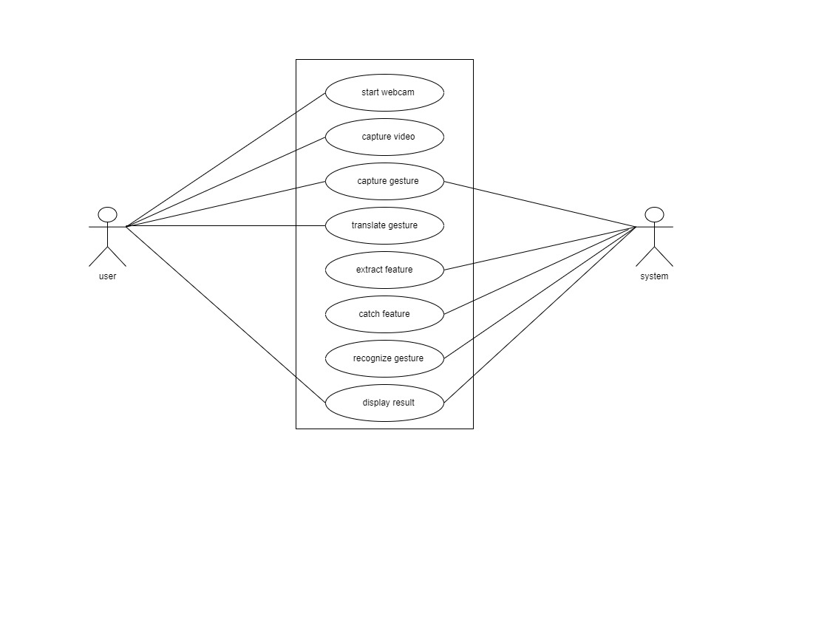
Usecase Daigram

Slide 11
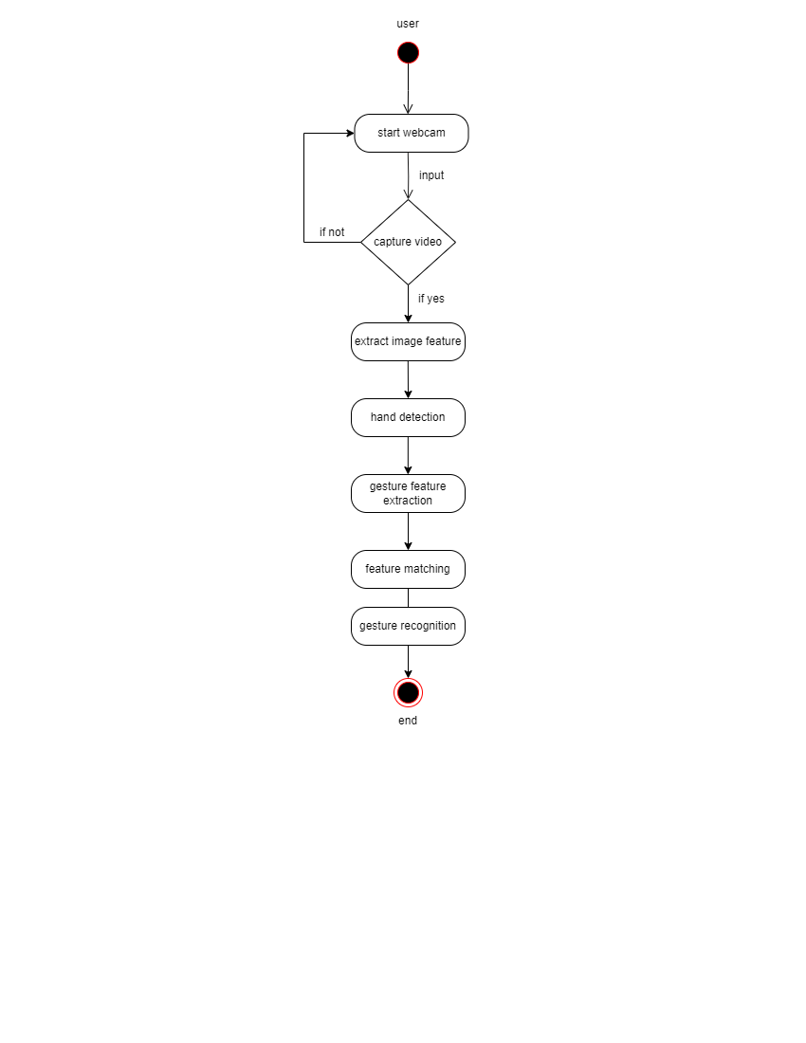
Activity Daigram

Slide 12
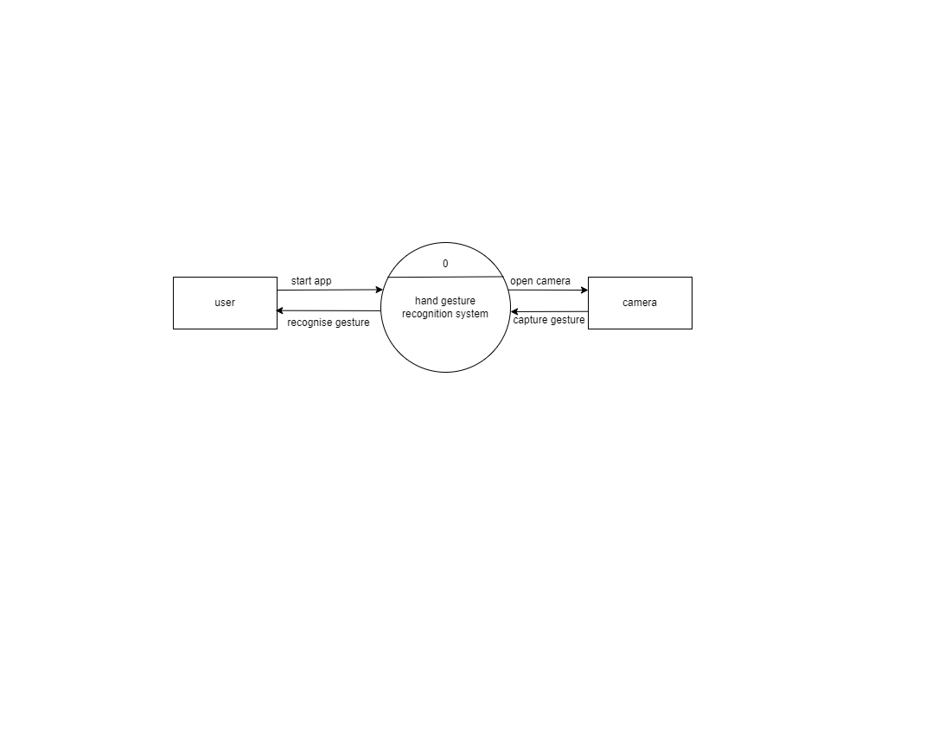
Data Flow Daigram

Slide 13
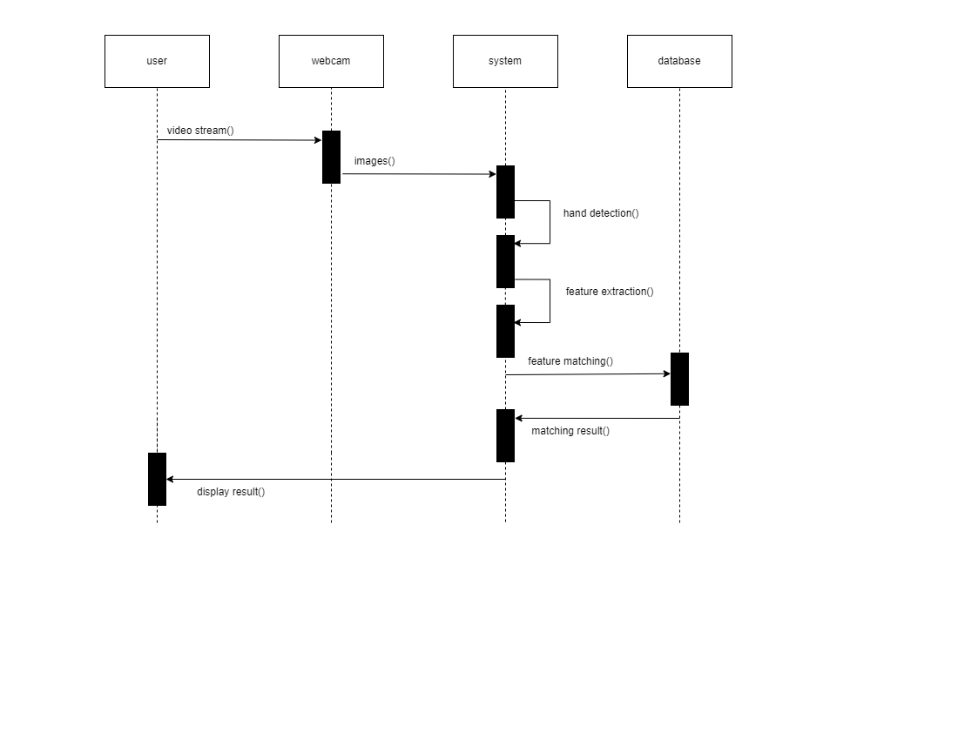
Sequence Daigram

